Slide 1
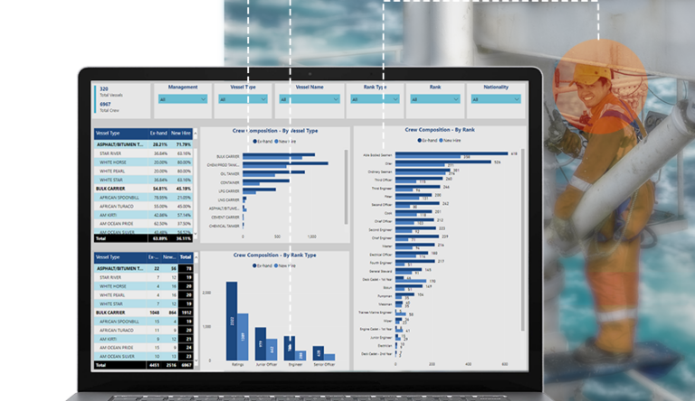

Slide 2

Shippalm V3
ADDED FEATURES ON SOFTWARE
Management of Change
Risk Assessment
Best Practices and Safety suggestion
Daily Work Planner
Office Audits
Ship shore drill
Vessel Rejections
Officer handover and takeover reports
Vessel inspection and audit tracker & planner

Slide 3




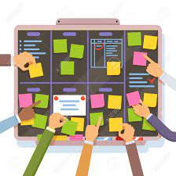








Shippalm V3
ADDED FEATURES ON SOFTWARE
Daily Work Planning
Management of Change
Audit tracker & planner
Safety Suggestion & Best Practices
Risk Assessment
Vessel Rejection
Officer Handover Takeover
Office Audit
Ship Shore Drill

